Slide 1

Basics of Neural Network Programming
Computation Graph
deeplearning.ai
Notes:
We have said that computation of a neural network are organized in Forward for computation & backward pass for computing gradients.
The computation graph explains why this is organized this way.

Slide 2
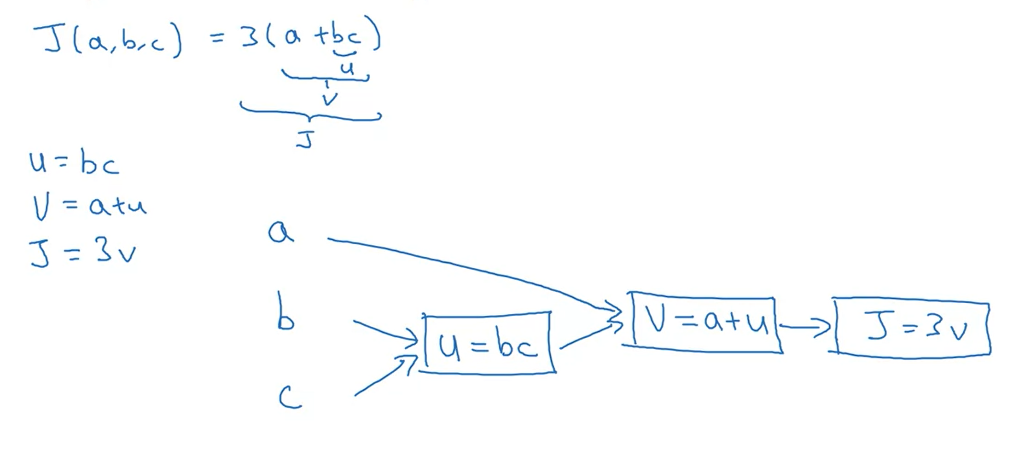
Computation Graph
Notes:
Lets use a simple example of 3 variables function.
Computing this function has 3 steps.
First step is to compute bc, we name it as u
Than v
& than J
We can take these 3 steps & draw a computation graph for them.

Slide 3
Why Computation Graph ?
Question : why do we need computation graph ?
Answer: Computation graph comes in handy when there is some distinguished/special output variable that we want to optimize (either minimize or maximize)
In our current slide we have J as that variable where as in logistic regression we have J as cost as our final/distinguished variable that we are trying to minimize.
In this example, we have seen that from left to right we have computed the value where as for computing the derivative we need to go opposite.

Slide 4
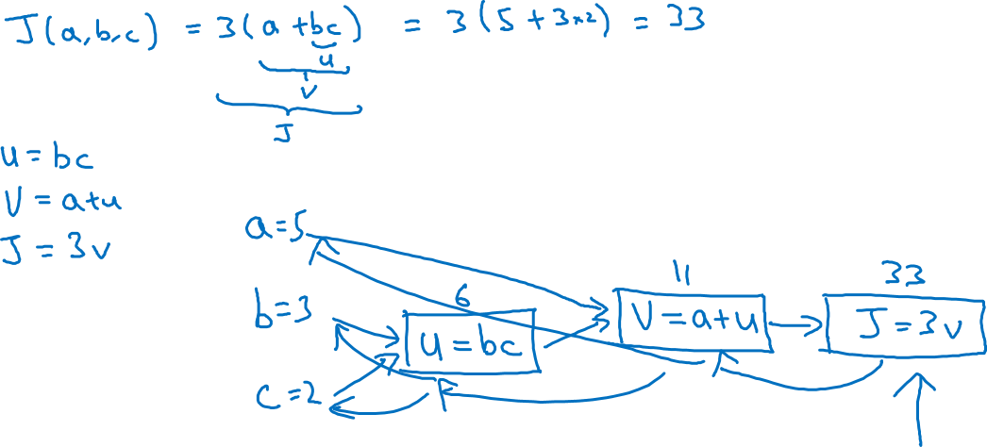
Computation Graph
Notes:
Here we assign values to make a concrete examples, bc becomes 6 & so on.
We can verify by putting the values like we normally do.
J is the cost function which we are trying to minimize, here in this example, through a left to right pass we computed J & to compute the derivatives of J with respect to different parameters we go in the opposite direction which is shown by red arrows.
In the next video we see about how backward computation works.

Slide 5
Basics of Neural Network Programming
Derivatives with a Computation Graph
deeplearning.ai
Notes:
Previously, we computed J.
We can use it to figure out derivative calculations.
I have created a separate slide for this section.

Slide 6

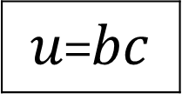



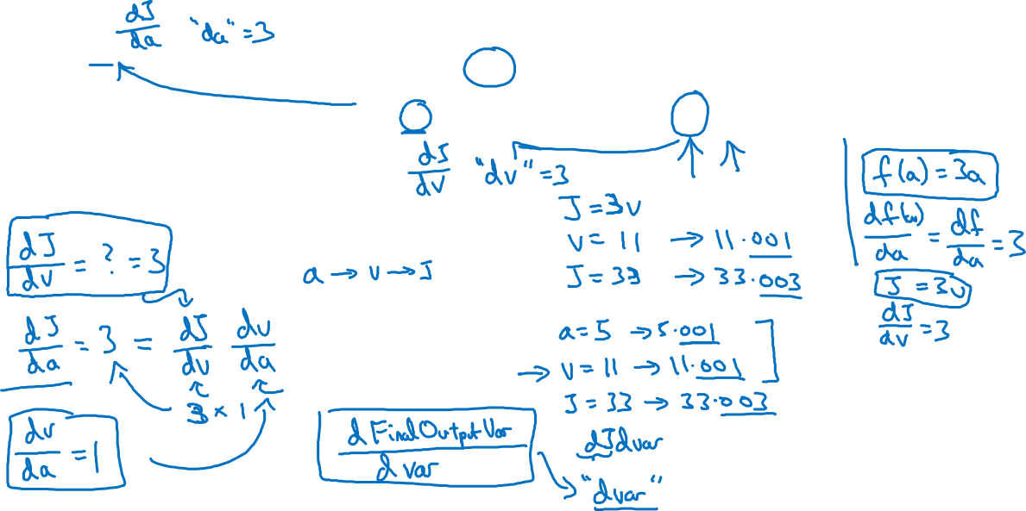
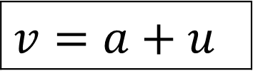
Computing derivatives
$$a=5$$
11
33
$$b=3$$
6
$$v=a+u$$
$J=3v$
$u$=$bc$
$$c=2$$

Slide 7
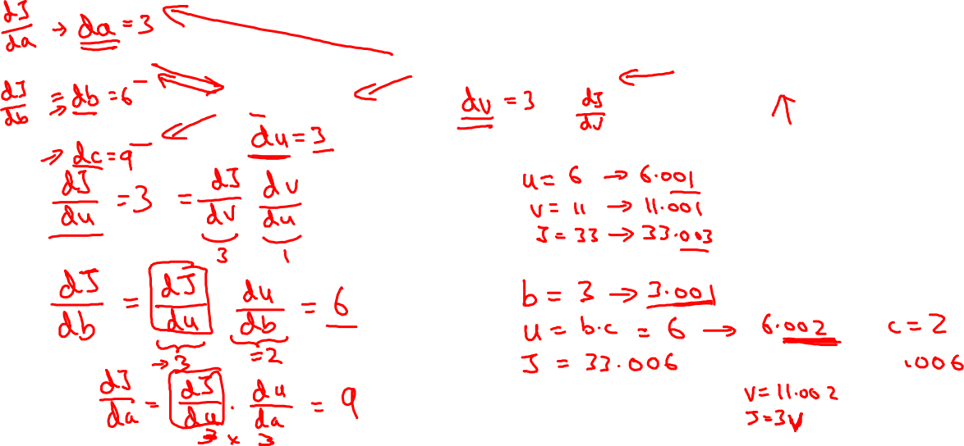
Computing derivatives
$$a=5$$
11
33
$$b=3$$
6
$$v=a+u$$
$J=3v$
$u$=$bc$
$$c=2$$

